Slide 1
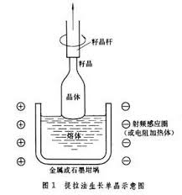
Why the pulling method involves a rotation operation when it is applied on the growth of Si crystals?
Answers: Since new nuclei may form due to large vertical temperature gradient, rotation operation can keep the temperature balance across crystal growth interface, inhibiting the growth of polycrystals.
Try to think with your own brain firstly
Google, Bing & Baidu
http://www.answers.com
http://en.wikipedia.org/wiki/Wiki
LIBRARY
Discussion
Notes:
第29回，小霸王怒斩于吉 碧眼儿坐领江东
策曰：弟才胜儿十倍，足当大任。倘内事不决，可问张昭；外事不决，可问周瑜。恨周瑜不在此，不得面嘱之也！

Slide 2
Chapter 3 Classification of space lattice and crystallographic symbols
Space lattice
Classification of space lattice （空间格子）
Primitive cell, Wigner Seitz primitive cell and unit cell.
7 crystal systems, 14 space lattices;
Node, Crystallographic direction, lattice plane and Miller index
Denotation of node, crystallographic direction and plane;
Denotation of direction and plane in hexagonal crystal system;
Zone axis law.
Notes:
在第一章，在得到点阵之后，我们发现点阵点很多，周期性排布，如果划分成格子就比较容易记得它的特征。。。特殊的对称性
Degree of freedom

Slide 3
I. Space lattice
Elements of a spatial lattice (review)
motif（结构基元，质点的集合）
node (结点) ，lattice point (格点或阵点)
row (行列)，net (面网)
space lattice (空间点阵)
motif
node
row
net
Crystal
Structure
lattice
Abstract one motif as one lattice point
Crystal structure = motif + lattice
Notes:
晶体内部最基本的特征是具有格子构造，即晶体内部的质点在三维空间呈周期性排列。这种质点排列的周期性，可以抽象成只有数学意义的周期性图形，称为点阵（lattice），也叫空间点阵（space lattice）。空间点阵中的每一个点称为阵点（lattice point）。
晶体也可以看成是平行六面体-空间格子重复而成。
原胞是结构基元，但结构基元不是原胞，可以是各种形状，但是两者的体积一定相等。

Slide 4
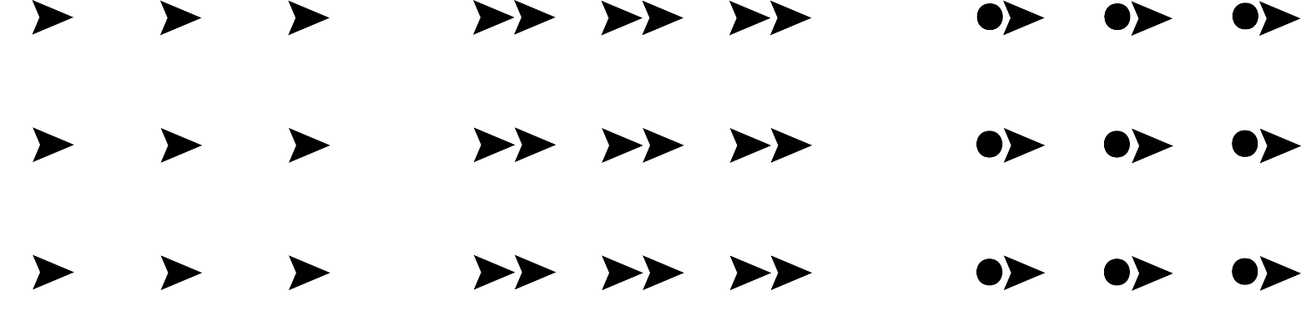
Motif and Lattice
Crystal structure can be represented by a translation of equivalent point in space and the entity represented by equivalent point is called primitive element (or motif，基元), which does not have to be a parallelogram (平行四边形）.
Abstracting motif as point and repeating regular arrangement in space will form a space lattice (空间点阵). The corresponding points called lattice points (阵点).
Notes:
Parallelogram 英 /ˌpærə'leləgræm/

Slide 5
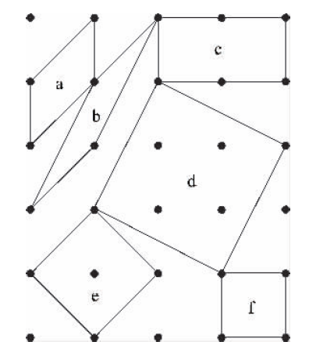
2. Lattice
The choice of parallelepiped cell in 3D lattice
For each crystal structure, the distribution of nodes (or lattice arrangement) is objective, but the choice of parallelepiped is subjective.
2D lattice
3D lattice
Notes:
能反应平移不变性的平行六面体有很多，体积也可以不是最小。
任意选择的平行六面体不便反应晶体的结构特征和在一个统一的标准下对晶体结构进行研究。

Slide 6
2. Lattice
The choice of parallelepiped cell
There are many parallelepipeds that can reflect translational invariance of a crystal, and their volume does not have to be the minimal.
Subjective selection of parallelepipeds is not convenient for the reflection of structural characteristics of crystal and structural studies.
The parallelepiped cell chosen according to the unified rules in crystallography gives “Bravais lattice”
Notes:
能反应平移不变性的平行六面体有很多，体积也可以不是最小。
任意选择的平行六面体不便反应晶体的结构特征和在一个统一的标准下对晶体结构进行研究。

Slide 7
3. The principle for choosing cells of Bravais lattice
(1) the selected parallelepiped must fully reflect the point group and the translation group of the studied lattice, that is, the parallelepiped must be consistent with the symmetry characteristics of the entire lattice.
(2) the chosen parallelepiped should have the most number of right angles. If there is no right angles, choose the parallelepiped with angles as close as possible to right angle.
(3) In addition to meeting the above (1) (2) requirements, the chosen parallelepiped should be of the smallest size.
The above parallelepiped is called Bravais cell, crystallographic unit cell, referred to as unit cell (晶胞）. Unit cell is the smallest structural element that can fully reflect the symmetry characteristics of crystal structure.
Notes:
晶胞（Unit Cell）能完整反映晶体内部原子或离子在三维空间分布之化学-结构特征的平行六面体最小单元。其中既能够保持晶体结构的对称性而体积又最基本特称“单位晶胞”，但亦常简称晶胞。

Slide 8
Primitive Cell and Wigner-Seitz Cell
Primitive cell (初基原胞) is the smallest repeating unit that constitutes crystal lattice, also named as primitive unit cell (原胞). The vectors describing primitive cell are primitive translation vectors, or base vectors (基矢).
For a certain crystal, the selection of primitive unit cell is subjective while only one kind of bravais lattice or unit cell.
For convenience, we usually choose the primitive cell with each side as the shortest translation vector of the lattice.
Notes:
在倒格子空间中的WS原胞，也就是晶体中的晶体格波和电子的简约Brillouin区（布里渊区）。
只要求体积最小就得到了原胞 原胞的选择也不是唯一的，但是必须只包含一个节点，是晶体结构的最小单元，选取原则 是尽量使得各边都是点阵的最短平移矢量。

Slide 9
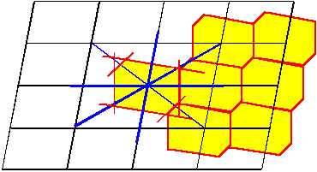
Wigner-Seitz Cell is also a common cell form. The selection method is as follows: On the base of crystal lattice, connect one lattice point with its nearest point and then make the perpendicular bisector of these lines, the enclosed area is the Wigner Seitz primitive cell.
Notes:
perpendicular bisector

Slide 10
Primitive cell and unit cell
Primitive cell | The smallest repeat unit that constructs lattice | 原胞
Unit cell | The smallest repeat unit considering the symmetry of crystals | 晶胞
The volume of unit cell is always one or several times of primitive cell.

Slide 11
Practice 1：choose 2D bravais lattice
Plot the corresponding Bravais lattice/ unit cell of the following 2D patterns：
4mm(L⁴4P)
mm2(L²2P)
Notes:
有同学问为什么右图中晶胞不能选为菱形；我们选择布拉菲格子的第一条菱形是满足的，但是与带心的矩形比，它的直角不是最多，因此还是选择带心的矩形作为晶胞。

Slide 13
4mm

Slide 14
mm2

Slide 15
Practice 2：choose the unit cell of 2-D hexagonal lattice

Slide 16
Which one？

Slide 17
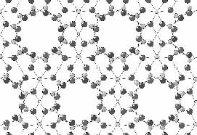
Space lattice
Motif
Primitive cell
The projection of beryl crystal structure along z axis
Bravais lattice
Equivalent point
Unit cell
Crystal structure➔Space lattice➔Bravais lattice

Slide 18
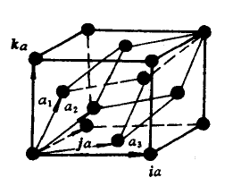
Primitive cell and unit cell of cubic crystal systems (FCC and BCC)
The primitive cell and unit cell of face-centered cube
The primitive cell and unit cell of body-centered cube

Slide 19
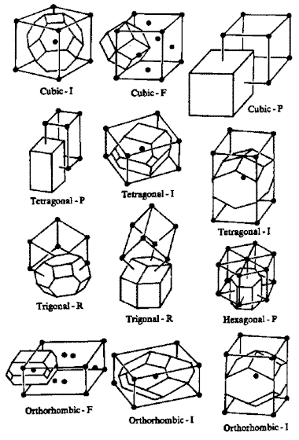
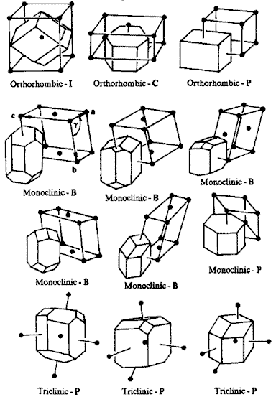
24 distinct forms of wigner-seitz cells

Slide 20
4. Classification of 3-D space lattice
The space lattice of crystal can be divided into seven kinds of parallelepipes, corresponding to seven crystal systems and 14 kinds of Bravais lattices.
Cubic (isometric) system 立方（等轴）晶系 ；
Tetragonal system 正方（四方）晶系 ；
Hexagonal system 六角 (六方）晶系 ；
Trigonal system 三角（三方，菱方）晶系 ；
Orthorhombic system 正交（斜方）晶系 ；Monoclinic system 单斜晶系 ；
Triclinic system 三斜晶系 。
如何记忆：“斜角方交” ：
三斜，单斜；三角，六角；正方，立方；正交（斜方）。
Notes:
如何记忆：“斜角方交” ：
三斜，单斜；三角，六角；正方，立方；正交（斜方）。
晶体通常可以分为七个不同的晶系，即等轴（立方）晶系、六角（六方）晶系、四方（正方）晶系、三角（三方、菱方）晶系、斜方（正交）晶系、单斜晶系、三斜晶系

Slide 21
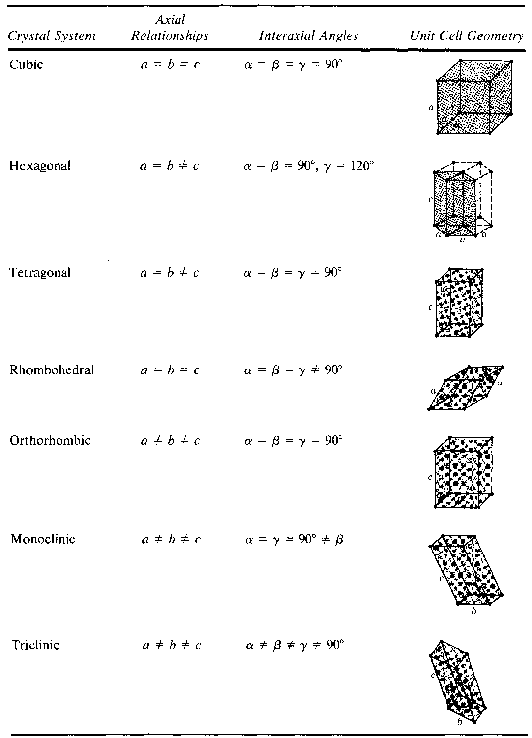
4. Classification of 3-D space lattice
Notes:
如何记忆：“斜角方交” ：
三斜，单斜；三角，六角；正方，立方；正交（斜方）。
晶体通常可以分为七个不同的晶系，即等轴（立方）晶系、六角（六方）晶系、四方（正方）晶系、三角（三方、菱方）晶系、斜方（正交）晶系、单斜晶系、三斜晶系

Slide 22
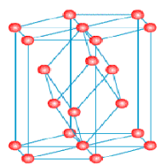
Hexagonal unit cell can be found in the lattices of both trigonal crystal system and hexagonal crystal system, thus it has the symmetry characteristics of both trigonal crystal system and hexagonal crystal system.
Additionally, we can also find the trigonal unit cell in the lattices of hexagonal crystal system.
Notes:
右上图晶胞可以是六方，也可以是菱方

Slide 23
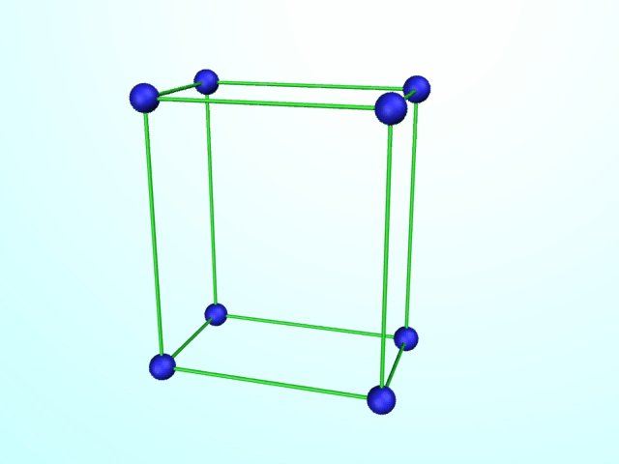
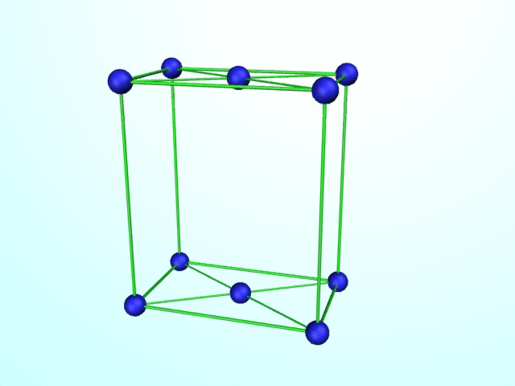
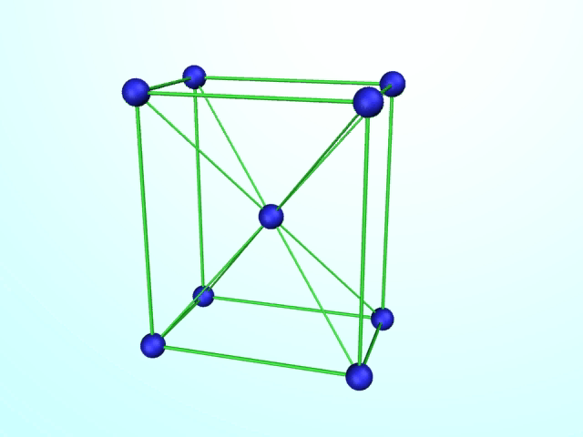
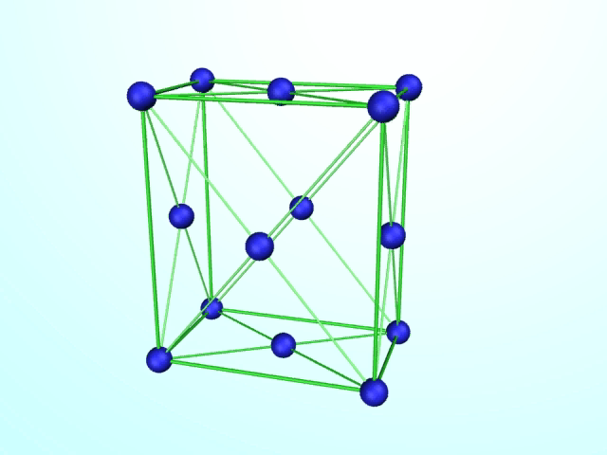
5． Lattice type and the distribution of lattice points in parallelepipeds
1）Primitive lattice （P, 原始格子）：nodes occupy the eight vertices of parallelepiped.
2）End-centered lattice（C、A、B, 底心格子）：nodes occupy the eight vertices of parallelepiped and two face centers of a pair of parallel planes.
3）Body-centered lattice （I, 体心格子）：nodes occupy the eight vertices and the body center of parallelepiped.
4）Face-centered lattice（F, 面心格子）：nodes occupy the eight vertices and six face centers of parallelepiped
Notes:
PCIF

Slide 24
Note: the difference between lattice point（格点） and node（结点）
They are both equivalent points；lattice points (格点) only occupy the eight vertices of parallelepiped(格子)；besides vertices, nodes can also occupy end-center, face-center and body center of parallelepiped.
Limited by the corresponding symetry characteristics in some certain crystal systems, Bravais lattice can not be chosen as primitive lattice but as centered lattice (由于某些晶体的对称性的限制，晶胞只能选为带心的).

Slide 25
14 bravais lattices
7 crystal systems
→ 7 crystal parameters→ 7 parallelepipeds
Every kind of parallelepiped has 4 possible types, but there are only 14 kinds of Bravais lattices instead of
7 x 4 = 28.
Among the 28 theoretically possible lattices, however, some types of lattices are duplicated and convertible with each other. Some do not conform to the symmetry of a certain system and cannot exist in the system. Thus, only 14 kinds of space lattice can be finally obtained, also called the 14 Bravais lattices. (Firstly derived by A. Bravais in 1848)^{MP}

Slide 26
14 bravais lattices
End-centered tetragonal lattice is actually the primitive tetragonal lattice with a smaller volume.
Example 1：End-centered tetragonal lattice ＝ Primitive tetragonal lattice

Slide 27
14 bravais lattices
Example 2：End-centered cubic lattice, which does not have the symetry characteristics of 4L³, cannot exist，but the face-centered cubic lattice can exist.
Notes:
In the cubic crystal system, if the centers of a pair of parallel planes are occupied by nodes, the final lattice will not have the symmetry characteristics of 4L³ (Figure 3-14 in textbook), thus the existence of end-centered cubic lattice is impossible

Slide 28
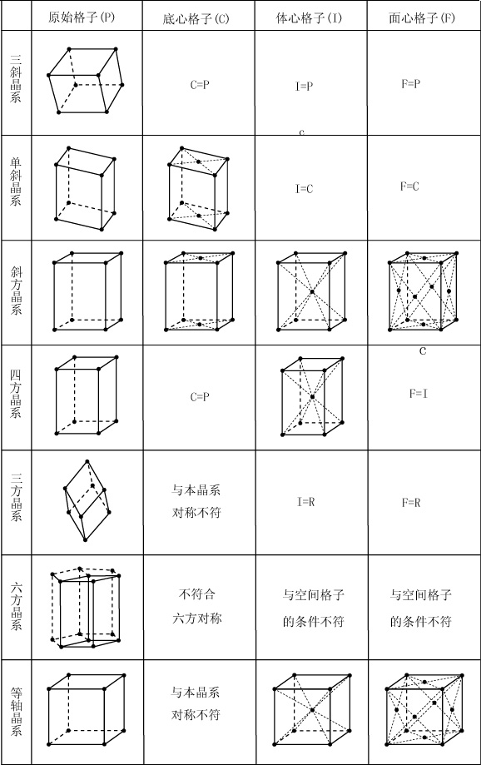
14 bravais lattices
P
C
I
F
Triclinic
Monoclinic
Orthorhombic
Homework: Please derive 14 bravais lattices
Tetragonal
Trigonal
Inconsistent with the symmetry of the crystal system
Rhombohedral
Inconsistent with the condition of the space lattice
Hexagonal
Cubic

Slide 29
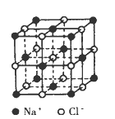
14 bravais lattices
CsCl
Crystal Structure
Practice 3：
Please point out the lattice type of NaCl and CsCl crystals, respectively.
Notes:
CsCl 简单立方；cesium chloride
NaCl 面心立方；sodium chloride

Slide 30
14 bravais lattices
Shape and Size of Parallelepipeds
in Different Crystal Systems
The shape and size of parallelepipeds can be determined by the length of three edges (axis), referred to as a, b and c, as well as the three angles between them, α, β and γ, all of which are called lattice parameters.
Notes:
In the macroscopic morphology of the crystal, we can get the crystal parameters of each crystal system, which is based on the crystal axis symmetry. The characteristics of the microscopic lattice parameters correspond to the macroscopic crystal parameters, furthermore we can get the specific values of the lattice parameters in the microscopic crystal structure.

Slide 31
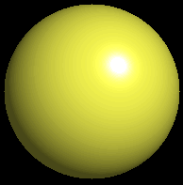
c
c
c
b
b
b
a
P
P
C
a
a
Triclinic
Monoclinic
α
≠ β
≠ γ
α =
γ
= 90
≠ β
ο
a
≠
b
≠
c
a
≠
b
≠
c
c
b
a
P
C
F
I
Orthorhombic
α =
β
=
γ
= 90
ο
a
≠
b
≠
c

Slide 32
c
c
a
2
a
a
2
a
1
P
I
1
P
R
Tetragonal
Hexagonal
Rhombohedral
α =
β
=
γ
= 90
ο
a
= a
≠
c
α =
β
= 90
ο
γ
=
120
ο
α =
β
= γ
≠
90
ο
1
2
=
≠
a
a
c
a
=
a
= a
1
2
1
2
3
a
3
a
2
a
P
1
F
I
Isometric or Cubic
α =
β
=
γ
= 90
ο
a
= a
= a
1
2
3
Notes:
Hexagonal → Rhombohedral

Slide 33
Homework
Please classify the 2-D Bravais lattices and point out the properties of their lattice parameters.

Slide 34
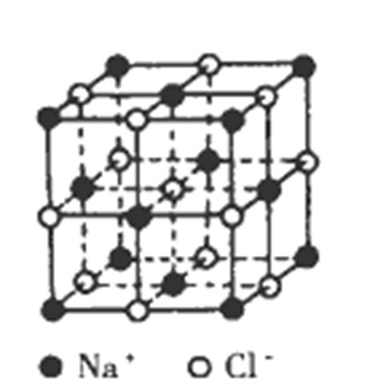
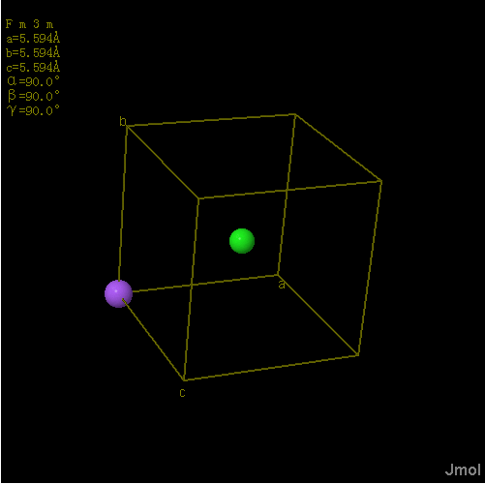
Elements of unit cell（晶胞要素）
1. Lattice parameters（ a, b, c ; α, β, γ）（晶胞参数）
2. Space group
3. Coordinates of each atom in unit cell

Slide 35
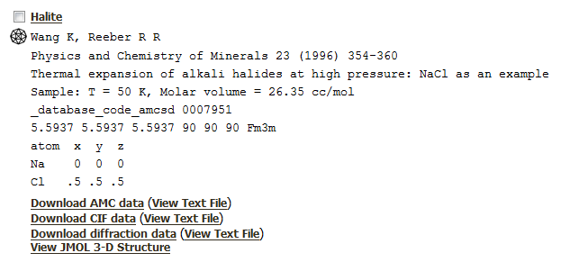
Elements of NaCl crystals
Space group symbol
Database for cystal structures
http://rruff.geo.arizona.edu/AMS/amcsd.php
Notes:
sodium chloride

Slide 36

II. Denotation of node （结点）, crystallographic direction and lattice plane
Crystallographic coordinate system (basing on unit cell)：
There are two coordinate systems basing on the basis vectors (a₁, a₂, a₃) of primitive cell and the basis vectors (a, b, c) of unit cell, respectively, which can be both used as the symbol of crystals.
The latter one (basing on unit cell) is commonly used, because unit cell is the the simplest unit that represents all the structural characteristics of a crystal.
VS. rectangular coordinate system （直角坐标系）

Slide 37
1. Denotation of node:
The coordinate of a node can be obtained via plot the vector r from the origin to the node. The vector r can be expressed in the form of the combination of a, b and c, like r =ua+vb+wc, and the corresponding index （系数）of the node is expressed as [[u v w]].
The index of node indicates the coordinate of a lattice point （格点）in space lattice and the index values of the nodes occupying the vertices（顶点） are integers.
Notes:
他们都是等效点；格点在格子平行六面体的顶点；结点除了在顶点外，还可以在底心，面心和体心。
They are both equivalent point；lattice points only occupy the eight vertices of parallelepiped；besides vertices, nodes can also occupy the end-centers, face-centers and body center of parallelepiped.

Slide 38
1. Denotation of node:
C
The coordinate of node A is (1a, 2b, 0c), and the index is [[120]];
1.What are the coordinate and index of nodes B and C, respectively？
2. A, B and C are also lattice points?
Notes:
他们都是等效点；格点在格子平行六面体的顶点；结点除了在顶点外，还可以在底心，面心和体心。
They are both equivalent point；lattice points only occupy the eight vertices of parallelepiped；besides vertices, nodes can also occupy the end-centers, face-centers and body center of parallelepiped.
coefficient 系数
double brackets

Slide 39
The atom arrangement varies with the crystallographic directions and planes.
Thus, many properties and behaviors of materials (such as various physical properties, mechanical behavior, phase transformation, X ray and electron diffraction characteristics) are strongly dependent on the crystallographic directions and planes.
In order to investigate and describe the properties and behaviors of materials, the denotation of crystallographic planes and directions is firstly required.
Miller index is commonly used to denote the lattice planes and directions.

Slide 40
2. Denotation of crystallographic direction
Crystallographic direction: the directions of arrays in the spatial lattice or the directions of the straight lines connecting nodes in the lattice.
These directions in crystals, involving positions of atoms in the crystal and the orientation of the atom array, indicate the directions of a group of parallel, straight lines.

Slide 41
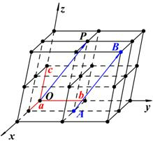
The method to denote the index of crystallographic directions
1. Build a coordinate system based on unit cell with one lattice point as the origin and the sides of the unit cell (a, b and c) as the axes. Note the unit length of the axes is the length of the sides, a, b and c, respectively.
2. Plot a straight line OP through the origin and lattice point P, which is parallel to the crystallographic direction to be denoted, AB (see right figure), and this line must pass through some lattice points;
3. Choose the closest lattice point, P, to O on the line OP, and get the coordinate (xa, yb, zc) of P；
4. Reduce x, y, z to the simplest integer ratio u, v, w, and keep u: v: w = x: y: z, set the number group inside a bracket [ ].
5. [u v w] is the index of crystallographic direction AB. If one of u, v and w is negative, plot the minus symbol on the top of that number.
[112]
Notes:
Ray 射线

Slide 42
Denotation of crystallographic directions
a. The significance of index: representing all the parallel crystallographic directions.
b. Minus value: the minus symbol should be on the top of numbers, indicating the opposite direction of another crystallographic direction, such as and [111].
c. The family of crystallographic direction: a series of directions passing through the same atom arrays in the crystals but not parallel to each other, expressed as <uvw>
[111]

Slide 43
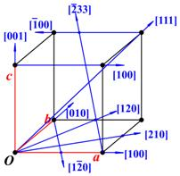
DEnotation of crystallographic directions

Slide 44
Practice4：DEnotation of crystallographic directions
Please plot the directions in the left picture, [001],[101], [110], [1-10], [1-11], [112] and [12-3], respectively
Draw up all of the directions belong to the family of direction <111>.
Notes:
晶向族<111>包括8个111晶向

Slide 45
3. Denotation of crystallographic planes:
Crystallographic plane: planes passing through a group of lattice points (the plane composed of the nodes in the space lattice). These planes are composed of atoms in crystals.

Slide 46
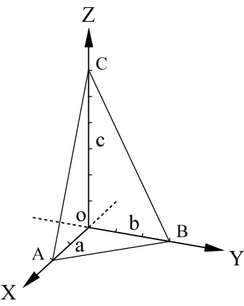
Determination of index of planes:
1．Build a coordinate system with the sides of unit cell as X, Y and Z axes. Set the side lengths of unit cell as the unit lengths of the axes, respectively；
2．Get the intercepts of the studied plane on the axes, respectively (if the plane is parallel to one of the axes, the corresponding intercept should be ∞), such as a, b, ∞；a, b, c；a, 2b, 1/2c；etc.;
3．Calculate the reciprocal of these intercept coefficients，such as 110，111，214, etc.；
4．Simplify these numbers into the simplest interger ratio，which are enclosed into parentheses “()” (圆括号)
. As a result, the index of planes can be expressed in the form of (hkl)，such as (110)，(111)，(112), etc.

Slide 47
Denotation of crystallographic planes
The meaning of index: representing a series of parallel crystallographic planes.
The meaning of index value 0: the plane is parallel to the corresponding axis.
Parallel planes: the parallel planes have the same or opposite index.
If a plane (uvw) is parallel to a direction [hkl], hu+kv+lw=0.
If a plane (uvw) is perpendicular to a direction [hkl], u=h, k=v, w=l, applicable only in the cubic crystal system.

Slide 48
group of planes
For crystal systems with high symmetry, there are usually some planes with the same atom distribution, but they are not parallel to each other. These planes belong to the same group of planes(界面族）, enclosed by braces {}, such as {abc}.
For example, the planes (111), (-111), (1-11) and (11-1) belong to the group of plane {111}.(Note: the minus symbol of -1 shoud be actually set at the top of the number in the form of 1)
(hkl) represents a series of parallel crystallographic planes.
{hkl} represents the planes that have the same distribution of atoms but have different spatial directions.

Slide 49
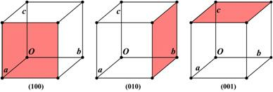
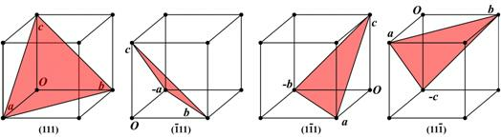
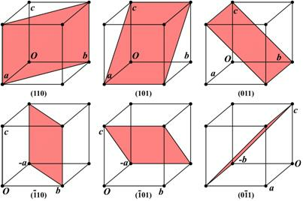
group of planes
{100}, {111} and {110}
in cubic crystal system
How many planes with different indices does {123} have?

Slide 50
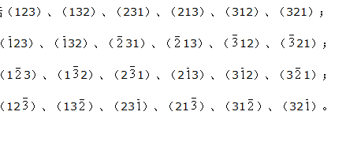
The family of plane
How many planes with different indices does {123} have?
Notes:
在立方晶系中，具有相同指数的晶向和晶面必定是相垂直的，即[hkl] 垂直于（hkl）。例如：[100] 垂直于（100），[110] 垂直于（110），[111] 垂直于（111），等等。但是，此关系不适用于其它晶系。
（C31*C21）*（C21*C21）*C21; 然后有123 和-1-2-3等同；因此总数要除以2
排列组合，3个位置，先选数字，再选符号，去掉平行的重复组合。

Slide 51
The family of plane
How many planes with different indices does {223} have?
How many planes with different indices does {023} have?
Notes:
在立方晶系中，具有相同指数的晶向和晶面必定是相垂直的，即[hkl] 垂直于（hkl）。例如：[100] 垂直于（100），[110] 垂直于（110），[111] 垂直于（111），等等。但是，此关系不适用于其它晶系。
（C31*C21）*（C21*C21）*C21; 然后有123 和-1-2-3等同；因此总数要除以2
排列组合，3个位置，先选数字，再选符号，去掉平行的重复组合。

Slide 52
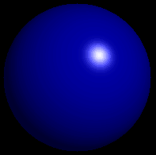
Denotation of plane
Example（2D）
unit cell shape
b
x = (1 2 0)
y = (1 1 0)
a
x
y
a
axial ratio = a:b = 0.80

Slide 53
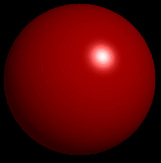
Practice5：denotation of plane
x = (？？？)
y = (？？？)
unit cell shape
b
a
x
b
y
a
axial ratio = a:b = 1.60
Notes:
x = (1 1 0)
y = (2 1 0)

Slide 54
Practice5：denotation of plane
XYZ = (1 1 1)
ABC = (h k l) = ?
c
C
Z
How about
XYZ = (1 2 3)
ABC = (h k l) = ?
O
A
X
Y
B
a
b
Notes:
ABC = (12， 3， 4)
ABC = (2， 1， 2)

Slide 55
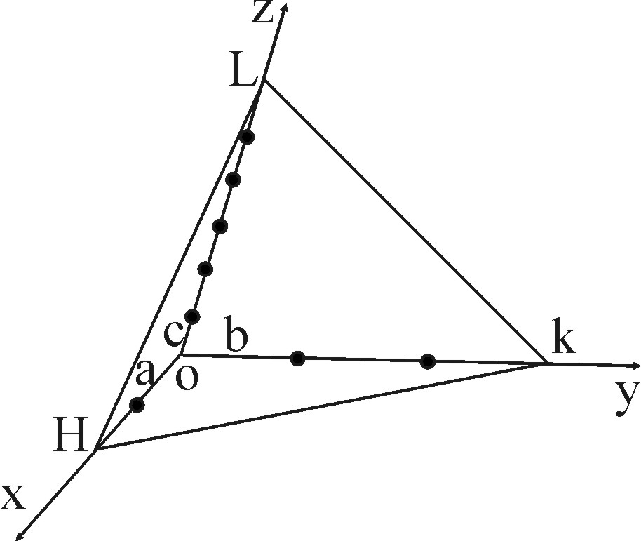
Tips for denotation of plane
Consider the HKL plane in the right figure. Get the intercepts of the plane on the axes X, Y and Z, which are 2a,3b and 6c, respectively. Thus the corresponding intercept coefficients and their reciprocals are (2,3, 6) and (1/2,1/3,1/6), respectively. After the reduction of the reciprocals to the simplest interger ratio, the Miler index of the plane can be obtained as (321).
Note: the unit length of the three axes may not be the same, therefore, the ratio of the intercepts may not be the same as the ratio of the corresponding intercept coefficients. The unit length of each axe is determined by the unit cell of crystals.

Slide 56
b
(1 1 0)
(2 1 0)
(1 0 0)
a
Can you index the rest?

Slide 57
denotation of plane
b
(0 1 0)
(1 1 0)
(1 1 0)
(2 1 0)
(2 1 0)
-a
(1 0 0)
(1 0 0)
a
(2 1 0)
(2 1 0)
-b
(1 1 0)
(1 1 0)
(0 1 0)

Slide 58
2. Index of direactions and planes in hexagonal crystal system
The index in the 3-axis coordinate system of hexagonal crystal system：
1. Build a coordinate syttem with a₁, a₂, c as axes，and the angle between a₁ and a₂ is 120° .（primitive cell coordinate system）
2. The indices of the six lateral planes should be (100), (010), (-110), (-100), (0-10), (1-10). Note, they are equivalent planes but with different indices.
c
a₂
a₁
the intercepts are (a, ∞,∞)

Slide 59
3. Similar phenomenon can be also found in direction indexing. For example, the direction [100] is equivalent to the direction [110].
4. In order to solve this problem, 4-axis coordinate system (unit cell coordinate system) is applied to index the hexagonal crystal system. The corresponding index is called Miler-Bravais index （密勒-布拉菲指数）.
c
a₂
a₁
[100]
[110]
4-axis system is built to solve the problem that equivalent planes and directions have different indices in hexagonal crystal system.

Slide 60
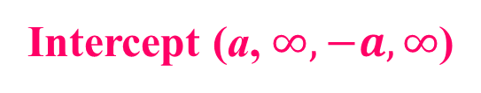
Index of directions and planes in hexagonal crystal system
The index in the 4-axis coordinate system of hexagonal crystal system：
1. Build a coordinate syttem with a₁, a₂, a₃ and c as axes, and the angle between a₁, a₂, a₃ is 120°；
2. The index h k l of plane can be obtained via the method mentioned before, but it requires four index numbers, expressed as (h k i l)；
3. According to the three-dimensional geometry, the number of independent axes can not exceed three.
In the above method, one of h, k, and i in the same
plane cannot be independent. The following relationship can be verified, i ＝ - (h ＋ k)；
c
Proof process refers to the reference P49-50
a₃
a₂
a₁
- a₃
Intercept (a, $∞,−a,∞$)
The indices of the six cylindrical surface of the above hexagonal prism are (10-10), (01-10), (-1100), (-1010), (0-110) and (1-100). These planes have the same index numbers and belong to the group of planes {10-10}.

Slide 61
Index of directions and planes in hexagonal crystal system
Practice 8：
denotation of planes
Q1. Please give the indices of the three colorful planes in the right picture based on three-axis and four-axis coordinate system, respectively；
Q2. Please plot the planes, (-112), (-1100), (11-20), (123) and (12-33) in the hexagonal unit cell.
c
a₃
a₂
a₁
- a₃

Slide 62
Index of directions and planes in hexagonal crystal system
Index of directions based on the four-axis coordinate system：
1. When the four-axis coordinate system is applied, the index of direction can only be determined directly from the three-axis coordinate system, and then converted to the four-index form [uvtw]. As discussed before, only two of u, v and t can be independent. Their relationship is defined as:
t ＝ －（u＋v）
2. The relationship between [UVW] and [uvtw] can be expressed as follows:
3.Equivalent directions have the same four indices but we cannot directly plot the direction according to [uvtw] since they do not have geometric meaning.
U = u −t ; V= v −t ; W=w
u＝[2U－V]/3; v＝[2V－U]/3; t＝-[U＋V]/3; w＝W

Slide 63
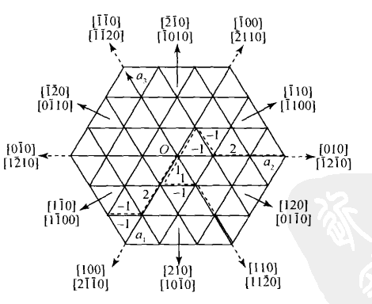
Index of directions and planes in hexagonal crystal system
Index of directions based on the four-vector coordinate system：
Notes:
Unify 统一

Slide 64
Index of directions and planes in hexagonal crystal system
Practice 9：
Q1. Please give the indices of the three colorful directions in the right picture based on the three-axis coordinate system and four-axis coordinate system, respectively；
Q2. Please plot the directions [101], [11-1], [121], [1-11]，[-2111] and [-12-11] in the hexagonal lattice.
Q3. Point out in Q2 which of them belong to the same group of direction.
0.5a
c
0.5c
a₃
a₂
0.5a
u＝[2U－V]/3; v＝[2V－U]/3; t＝-[U＋V]/3; w＝W
U = u −t ; V= v −t ; W=w
a₁
- a₃
0.5a

Slide 65
Index of directions and planes in hexagonal crystal system
How to get the coordinates of a point in a Non – rectangular coordinate system （直角坐标系）? (supplementory)
Plot two lines parallel to the axes passing through the point to be determined；
2. According to the intersections between the two lines and the axes, the coordinates of the point can be obtained.
a₂
a₁
Notes:
rectangular coordinates, 直角坐标系

Slide 66
Index of directions and planes in hexagonal crystal system
How to get the coordinates of a point in a Non - Cartesian coordinate system? (supplementory)
Practice：
Give the coordinates of the points of A-E.
A
B
a₂
C
D
E
a₁

Slide 67
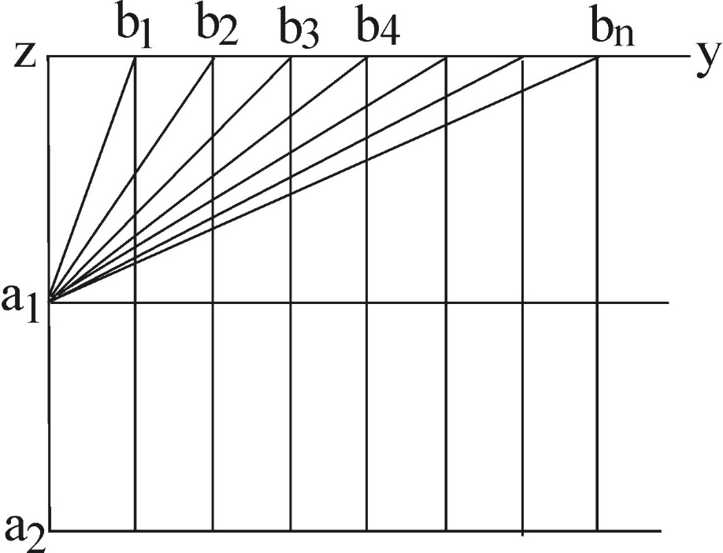
3. Integer law and zone law
Integer law（整数定律）
The ratio of the intercepts of any two crystal surfaces on real crystals is a simple integer ratio. （实际晶体任意两个表面对应的截距的比值为一简单整数比）
Explanation
The simpler the indices of crystal surface, the higher the corresponding reticular density （网格密度）. The growth speed of the planes with higher reticular density is relatively slow and it is easy for them to be remained as naked surfaces. Thus, the so-called crystallographic surfaces are planes with simple indices in real crystals.
Notes:
实际晶体外露晶面的晶面指数一般都是小的整数。
大大慢留，小小快无

Slide 68
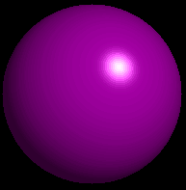
Bravais's law
The real crystals are surrounded by the planes with large surface density or simple indices.

Slide 69
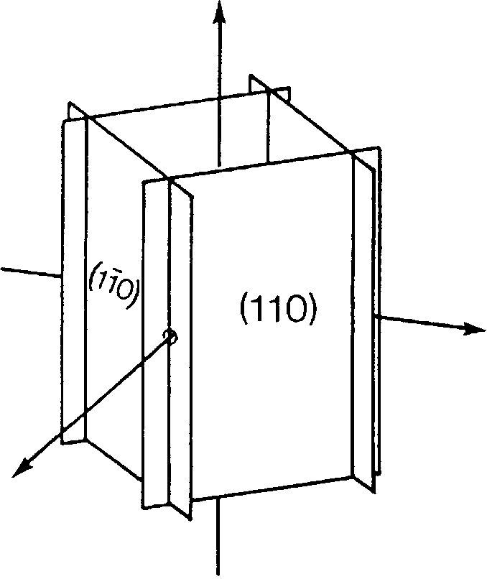
Zone（晶带） & Zone axis（晶带轴）
A set of crystal planes intersecting in parallel edges is called a zone.
The common direction of these edges is called the zone axis.
Consider the set of planes (110), (-1-10) , (-1-10) and (1-10) in the right figure, they intersect in four edges parallel to [001]. These planes form a zone with zone axis [001].
Notes:
若是在立方晶系，<110>有6个面，可以组成三个带轴。

Slide 70
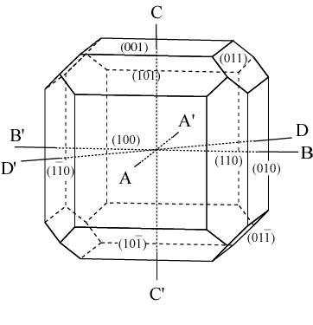
Zone & Zone axis
Exercise 10
The right figure shows a cubic crystal with several naked facets.
Please give the planes that belong to Zones AA’, BB’, CC’ and DD’.

Slide 71
zone law (晶带定律)
The intersection of two zone axes(crystal edge) can determine a possible crystal plane;
The intersection of two crystal planes can determine a possible zone axis (crystal edge).
Any plane(h k l) belonging to zone [u v w] must satisfy the following equation:
h u + k v + l w = 0 --- zone equation

Slide 72
zone law (晶带定律)
Simple proof（Mini PJ）
A general equation of the plane in 3-D space is :
Ax + By + Cz + D = 0
where the cofficients, A, B and C, determine the direction of the plane and the coefficient D determines the distance between the plane and the origin.
And the plane through the origin and parallel to plane (hkl) can be expressed as the equation: h x + k y + l z = 0.
Plane(h k l) belongs to zone [u v w] and any points on the straight line [uvw] can satisfy the equation hx+ky+lz=0, thus the equation hu+kv+lw=0 can be obtained.

Slide 73
Applications of zone law
Given two planes, get the zone containing the two planes；
Given two zones, get the indices of the plane belonging to the two zones；
Judge whether a plane belongs to a zone；
h u + k v + l w = 0 zone equation

Slide 74
Applications of zone law
For example：if a zone contains two planes, (h₁ k₁ l₁) and (h₂ k₂ l₂)，get the symbol of the zone.
According to the zone equation hu + kv + lw = 0：
h₁u + k₁v + l₁w = 0 (1)
h₂u + k₂v + l₂w = 0 (2)
Solve the equation group，
[u v w] = u : v : w = (k₁l₂ - k₂l₁) : (l₁h₂ - l₂h₁) : (h₁k₂ - h₂k₁)
Notes:
linear algebra 线性代数 integer 整数

Slide 75
practice11： Appl. Phys. Lett. 100, 103111 (2012)
(01-1)
(-201)
[???]

Slide 76
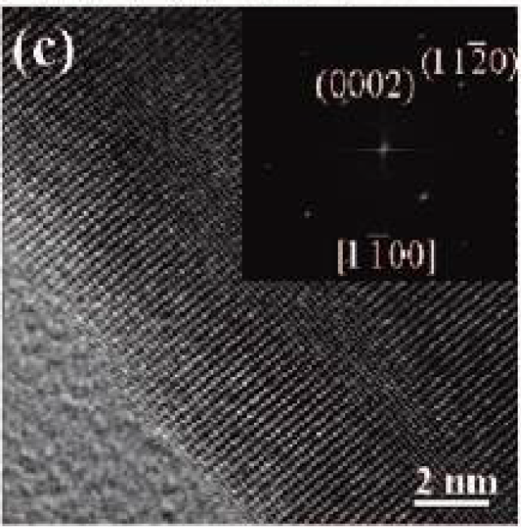
practice12： ACS Nano 3 (2009) 53
Zone Axis [????]
Notes:
[1-10]

Slide 77
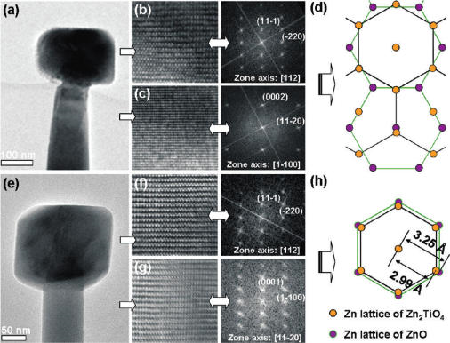
practice13： J. Phys. Chem. C 115 (2011) 78
Please give the calculation process to show how to get the zone axis in Figure b, c, f, and g.

Slide 78
Highlights：
The defination of unit cell；
7 crystal systems, 14 Bravais lattices；
Indexing of crystallographic planes and directions；
Indexing of the hexagonal crystal system based on 4-vector coordinate system and 3-vector coordinate system;
Zone law and its applications.

Slide 79
Homework
1. Practice 1-13 in this PPT；

Slide 80

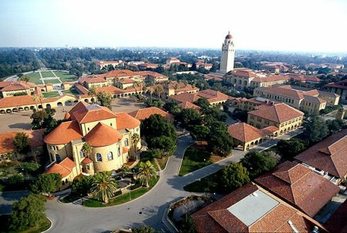

Stanford University

